Slide 1

Psychology and Social Media
Social Media Research

Slide 2
Social Media and Business Operations
Technology advancement has resulted in the development of social media.
Social media has gained popularity in the business world, mainly for marketing purposes (Dwivedi et al., 2021).
The use of social media platforms requires a detailed understanding of their operation.
Social media presents platforms that have eased business operations in general.
Notes:
Since the introduction of the internet in the early 21st century, various societal sections have drastically changed. An excellent example is the business section and how businesses are conducted. Initially, as a business person, to gain profits, one had to set up physical shops and conduct marketing and advertising on platforms such as newspapers (Dwivedi et al., 2021). However, due to the rise of the internet, platforms such as social media have developed, changing the whole perception of business operations. This is because social media presents interactions that facilitate communication between businesses and their consumers.
Consequently, this allows businesses to increase their brand awareness and engage their customers regarding their preferences (Dwivedi et al., 2021). However, in order to enjoy all the benefits that come with the use of social media in the digital transformation of businesses, entrepreneurs and business owners should seek to understand the dynamics involved in its use. Besides, when effectively utilized, social media presents platforms that ease business operations, increasing their efficiency.

Slide 3

About Social Media
Social media involves computer-based technology with virtual networks.
It uses these networks to facilitates the sharing of information and ideas.
It presents user-generated content from personalized profiles (Scott, 2015).
Statistics on the use of social media depict a projected increase in users, years to come.
Notes:
Computer-based technology has been made easy to access through gadgets such as personal computers and mobile phones with specific operating systems. Consequently, this has changed methods and media of communication between people around the world. This has been due to the introduction of social media, which has facilitated the introduction of virtual communities, allowing people to communicate in real-time irrespective of their distance and location (Scott, 2015). This has significantly impacted business since business owners now can reach more significant markets and grow from being local to international. However, in order to join the global community created by social media, it is vital to understand that these platforms only avail user-generated content, whereby the platform users create profiles through which they share their content and information to other users in the platform (Scott, 2015). Moreover, social media and associated platforms continue to increase their users over time; therefore, embracing the digital transformation of a business allows the tapping into the actively growing market potential.

Slide 4
Overall Impacts of Social Media
Social media has facilitated both positive and negative impacts.
The platform has negatively influenced the existing social morals and values (Hemsley et al., 2018).
It has also been deemed to create opportunities in different aspects, including business.
Understanding the dynamics of social media helps maximize the benefits in society.
Notes:
Similar to other inventions in society, social media has been associated with various impacts, some positive, others negative. According to Hemsley et al. (2018), most of the positive impacts of social media are often associated with income generation, while the negative impacts are often associated with the growing violation of social morals. However, being knowledgeable in the field would significantly enable increasing the positive impacts of social media platforms. For instance, in business operations, utilizing the platform to increase brand awareness and getting insights into the specific areas needing interventions in the business would significantly improve the benefits (Scott, 2015). In some cases, businesses use social media platforms for marketing their products but display content depicting unacceptable behavior in society. This adversely impacts the business in general and also the perception of social media. Therefore, one of the essential aspects of utilizing social media platforms is understanding the dynamics and what involves the violation of morals and ethics.

Slide 5
Platforms and Outlets in Social Media
Social media contains a wide variety of platforms and outlets.
The format of the content displayed on the different platforms also varies.
Some of the most commonly known platforms include Facebook, Instagram, YouTube, Pinterest, among others.
The formats displayed often include content in videos, messages, pictures, and podcasts (Kapoor et al., 2018).
Notes:
Over time, technology advancements have facilitated the diversification of the available social media platforms around the world. Additionally, this has also diversified the format of the content displayed on these platforms. For instance, some of the most platforms introduced at the beginning of the popularity of the internet and social media involved sharing content in the form of messages and texts (Kapoor et al., 2018). However, with technology advancement came more advanced technology gadgets that enabled the sharing of more content. Consequently, social media platform users can currently share more formats and high-quality formats, including videos, pictures, and audio recordings such as podcasts (Kapoor et al., 2018). Some of the most commonly known platforms include Facebook, which allows users to share pictures, videos, and texts to the extent of holding video calls. These features, similar to other platforms, have evolved. Another commonly known platform is YouTube, which allows users to post user-generated videos. Therefore, in this case, the format changes to video format.

Slide 6
Social Media Platforms considered Most Effective
Over time, a vast number of platforms have been developed.
The huge number of platforms has created the need to identify the most effective.
Various factors are considered including, the organization goals, buyer personas, and the amount of traffic drawn by the platform (Scott, 2015).
Some of the most effective platforms include Facebook, Instagram, and Websites.
Notes:
In order to excel with the use of these platforms, it is vital to identify a platform that meets the needs of the aimed function, whether it is to create brand awareness or market the products (Scott, 2015). In this case, the appropriacy of a platform depends on various factors that should be considered when one is identifying the most effective one to adopt in their business. In regards to business, one of the significant factors considered is the goal the use of the platform is intended to achieve. Each company often has specific goals, which it aims to achieve; therefore, the adopted platform should align with the same (Scott, 2015). Another factor considered is the buyer persona, which involves a buyer's representative, whose needs are met by the products or has an interest in one's organization. Once a buyer persona is identified, the identified platform should contain many users falling under the category. Also, identifying the traffic drawn by the platform is essential since it means more market for the business.

Slide 7
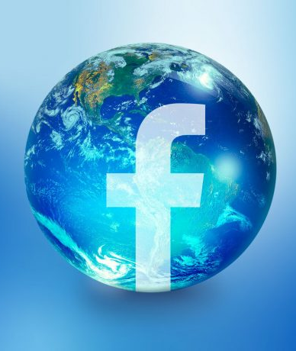
Summary of the Most Effective Platforms
1.Facebook
Introduced to the public in 2006, Facebook is ranked the most effective marketing tool for organizations.
The ranking is based on various reasons, including it being the most popular platform.
Facebook includes users from all demographics, widening the market pool (Evans et al., 2021).
Running an advert on Facebook is affordable compared to other platforms.
Notes:
As previously indicated, the effectiveness of a platform depends on various factors, which should be considered when employing the selected platform. However, based on research and statistics, one of the most effective platforms considered by users and business owners is Facebook (Poecze et al., 2019). Various reasons are often presented to support the idea that Facebook is one of the most effective platforms. One of the primary reasons is that Facebook is the most popular platform compared to other platforms. Precisely, as of 2021, the platform was ranked the top with the highest number of active users, which is more than 2.5 billion active users (Evans et al., 2021). This indicates that the platform has an active audience; therefore, as a business, employing a practical plan can yield positive results such as increased sales. Moreover, since the platform is international, its users are diverse since it includes people from different nations, developed and developing, and from different ethnicities. Additionally, the platform also offers an opportunity to its users to reach a bigger audience through advertising, which is considered one of the most affordable, costing about $5 an ad.

Slide 8
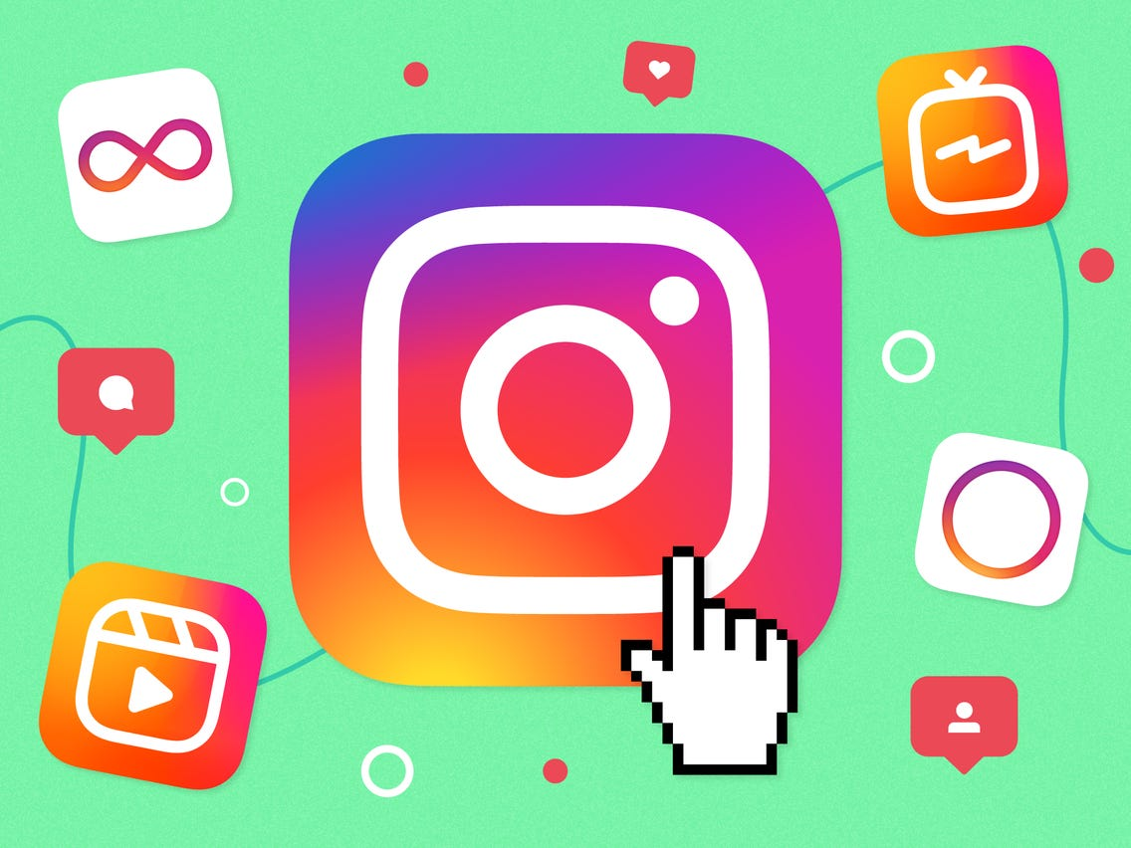
2.Instagram
This platform is one of the most rapidly growing platforms.
It is mainly effective for youth-related product businesses since it attracts younger populations (Evans et al., 2021).
About 90% of all users follow at least one business account.
It offers an environment that allows audience engagement, which is vital for businesses.
Notes:
Although Instagram is not the most popular, it is considered one of the most effective for various reasons. For instance, the platform is rapidly growing with increasing numbers of users annually. This provides an opportunity for business entrepreneurs to grow with increasing numbers. Moreover, unlike most platforms, Instagram is considered most effective when engaging the audience (Evans et al., 2021). This is because it offers a platform for users to post user-generated content in the form of pictures and videos, allowing the audience to react and give opinions on the same. Therefore, it facilitates the generation of feedback for those organizations requiring customer feedback. Moreover, it also allows the sharing of content in the form of polls, which is a good way of receiving general feedback. Notably, one of the most markets that Instagram is most effective for is the youth (Dwivedi et al., 2021). This is because more and more youths are actively engaging on the platform, presenting relevant data on how to personalize products.

Slide 9
3.Website
Most of the purchases made online are often made via a website (Scott, 2015).
It offers a platform for the provision of detailed information on the organization or business.
Most of the content presented is often in writing but can also include pictures and other formats.
A website presents the opportunity for the personalization of products and information.
Notes:
Most people often settle on making purchases from the organizations' official websites compared to other social media platforms. Therefore, this platform offers an environment for the customers to make purchases, impacting the sales (Scott, 2015). Moreover, unlike other platforms, websites present detailed information for the visitors to the websites to understand the products offered and present their questions. Therefore, this platform is effective for organizations whose goals include making their products available to a broader market. Besides, websites also offer the opportunity for organizations and businesses to provide other social media handles for the website visitors to explore. Also, website links can be attached to other social media platforms (Scott, 2015). This depicts the platform's flexibility in being utilized. Notably, websites require the inclusion of articles that employ search engine optimization, which involves increasing the website's visibility in the search results from search engines such as Google. Once adopted, organizations can also personalize information by providing links to different pages providing products based on specific needs.

Slide 10
A proposal on which Platforms to launch Social Media presences
The proposal is based on the most effective platforms.
Each platform presents various benefits worth utilizing.
To effectively utilize the benefits, it is vital to familiarize oneself with each platform's dynamics (Evans et al., 2021).
It is also essential to be conversant with the organization's goals and the target market.
Notes:
Before adopting any marketing strategy medium, especially the social media-related medium, adequate preparedness is essential. This saves the business time and money that social media demands to effectively reap the benefits (Evans et al., 2021). In this case, a proposal is made based on the identified effective platforms. Each presents an environment worth utilizing when addressing issues associated with creating brand awareness and increasing sales. Besides, some of the considerations before launching social media presence include understanding the business's goals and the target market. The goals may include increasing the purchases, creating awareness about the organization or the products, or engaging with the customers and the market in general (Scott, 2015). Additionally, the market can be identified by narrowing down the specific segment of the population that the business aims to meet the needs and the specific needs that the products presented meet. Understanding the dynamics of the platforms is also crucial to mainstream the goals of the organization.

Slide 11
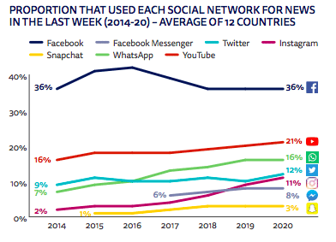
1.Facebook
As previously indicated, Facebook is considered the most effective online marketing tool.
Facebook presents a vast market inclusive of the largest online market.
It is an affordable platform, which presents an efficient solution to online marketing.
Various organizations have succeeded via the platform, for example, Amazon and AT&T (Poecze et al., 2019).
Notes:
Being ranked the most effective platform defines the reliability of Facebook as a platform for a business to launch its social media presence. Statistics indicate that more and more organizations and businesses continue joining the platform for online advertising (Poecze et al., 2019). The increase is due to the high number of markets present on the platform. Moreover, the platform has a diverse user profile, whereby users from all over the world are active users. This is an opportunity worth tapping into since the diversity of the users defines the high number of the target market based on the organization's buyer personas.
Moreover, one of the essential considerations when identifying the most suitable platform for advertising is the affordability of the service. With the vast number of users in the platform, Facebook offers affordable ad running opportunities, with about $5 per ad. Moreover, the platform also presents user tools that allow an organization to analyze the performance of an ad and establish the necessary changes required.

Slide 12
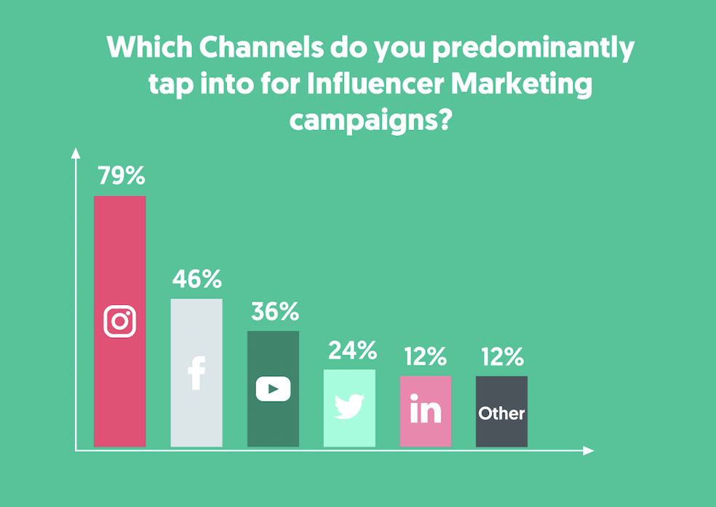
2.Instagram
This platform ensures guaranteed customer engagement via polls and comments.
It supports product descriptions with its visual nature through videos and imagery.
The possibility for the audience is higher since about 90% of the users engage with content generated (Adegbola et al., 2019).
It offers influencer marketing, which guarantees positive traffic on the business's page.
Notes:
Instagram is well known for its engagement characteristic. This presents an opportunity for any business to gain the required feedback from the consumers at any time. In any organization or business, feedback on the services offered or products provided is essential since it establishes the chance for the organization to become better and meet the customers' needs better (Adegbola et al., 2019). Additionally, it also helps the business to understand the customers more and personalize their products. The visual nature of the platform allows a business to offer both a visual representation of the offered products and a brief description of the same. In some cases, this combination builds on the customers' confidence in the organization. Moreover, one of the crucial tools that often makes Instagram a platform worth launching social media presence is influencer marketing. Instagram influencers often have a significant influence on most users' decisions on purchasing products (Adegbola et al., 2019). Therefore, utilizing this tool drives traffic towards the business's page and facilitates sales of the advertised product.

Slide 13
3.Website
It narrows down any form of ambiguity of the organization and presents a buyer-centric environment.
It offers an opportunity for customers to make orders remotely (Scott, 2015).
Through a website, a business can provide personalized services and products to customers.
A website facilitates brand awareness by availing detailed information.
Notes:
According to Scott (2015), a significant percentage of buyers globally always visit a website to make the needed purchases. This indicates that a website creates a doorway for increased sales since more customers access the products remotely. Moreover, although other platforms such as Instagram offer the opportunity for making purchases, most buyers prefer official business and organization websites to make the purchases. Additionally, personalization is essential in increasing customer loyalty in any business operation. A website offers a business opportunity to personalize the offered services and information, making the customer feel valued. Besides, brand awareness is essential to increase the organization's market scope; however, detailed information must be provided about the brand to avoid ambiguity. Therefore, since the content presented on a website often involves descriptions of the organization and the products provided, this offers brand awareness of all the operations in the organization or business.

Slide 14
References
Adegbola, O., Gearhart, S., & Skarda-Mitchell, J. (2018). Using Instagram to engage with (potential) consumers: A study of Forbes Most Valuable Brands' use of Instagram. The Journal of Social Media in Society, 7(2), 232-251.
Dwivedi, Y. K., Ismagilova, E., Rana, N. P., & Raman, R. (2021). Social media adoption, usage and impact in business-to-business (B2B) context: A state-of-the-art literature review. Information Systems Frontiers, 1-23.
Evans, D., Bratton, S., & McKee, J. (2021). Social media marketing. AG Printing & Publishing.
Hemsley, J., Jacobson, J., Gruzd, A., & Mai, P. (2018). Social media for social good or evil: An introduction. Social Media+ Society, 4(3), 2056305118786719.
Kapoor, K. K., Tamilmani, K., Rana, N. P., Patil, P., Dwivedi, Y. K., & Nerur, S. (2018). Advances in social media research: Past, present, and future. Information Systems Frontiers, 20(3), 531-558.
Poecze, F., Ebster, C., & Strauss, C. (2019). Let's play on Facebook: Using sentiment analysis and social media metrics to measure the success of YouTube gamers' post types. Personal and Ubiquitous Computing, 1-10.
Scott, D. M. (2015). The new rules of marketing and PR: How to use social media, online video, mobile applications, blogs, news releases, and viral marketing to reach buyers directly. John Wiley & Sons.

